Slide 1
The University of Queensland
School of Earth and Environmental Sciences
Inversion Using Finite Elements
Lutz Gross
E-mail : l.gross@uq.edu.au

Slide 2
Outline
Formulation of the inversion problem
  Gravity
  MT
Cost Function Gradient
Solver: BFGS method
FEM implementation

Slide 3
Inversion Problem
Positive regularization parameter

Slide 4

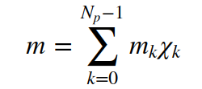
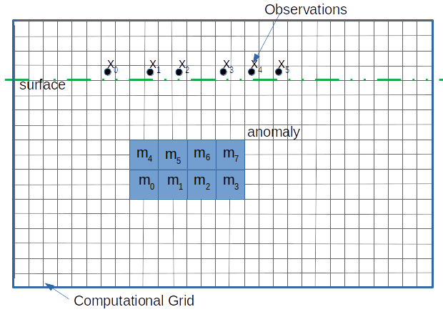
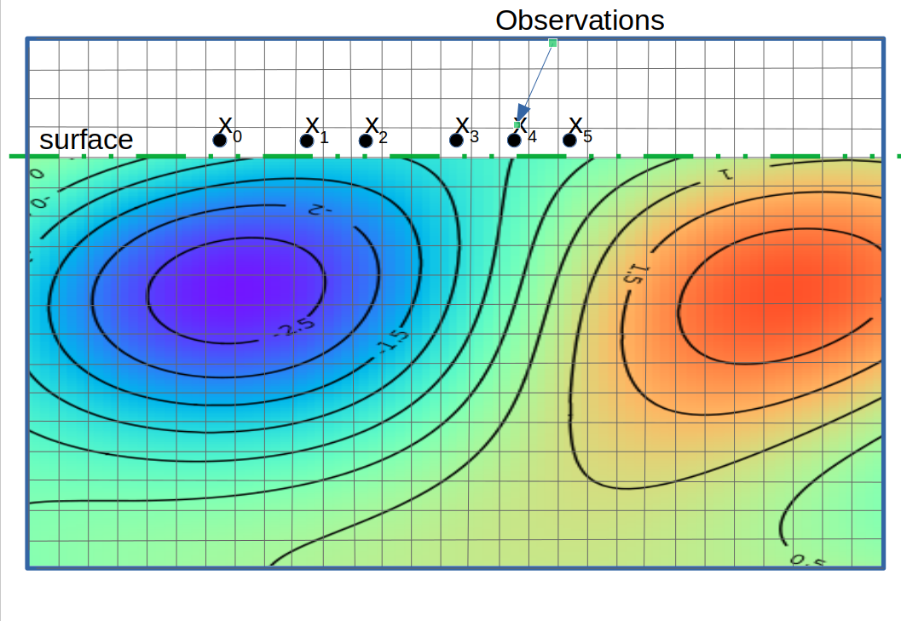
Property Function m
Before:
unknown is a vector of real values
Now:
unknown m is a function of x=(x₀,x₁)

Slide 5
Regularization
Now we use integrals and gradients
Before:

Slide 6
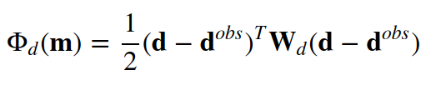
Misfit
Now we use integrals and weighting functions:
  Forward model: d=F(m)
  Weighting function w_{d}
Before:

Slide 7
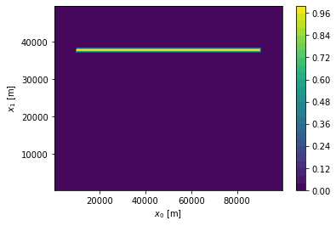
Weighting Function
Data are given here

Slide 8
Forward Model: Gravity
Parametrization of density
Gravity potential u from PDE:
Predicted data

Slide 9
Inversion Problem
We need a critical point condition for minimum m*

Slide 10
Towards a Critical Point Condition
For any increment δm for the property function:
The function
has a minimum at α=0.
Therefore

Slide 11
Gradient of cost function
Directional derivative of Φ at m along δm:
  Linear function of δm
Gradient of cost function Φ at m:

Slide 12
Critical Point Condition
Find m* with
for any increment δm
We need to calculate this gradient!?

Slide 13
Increments
We can see δΦ as a change of Φ due to a `tiny` change δm to m:
Idea is to track the changes through from the property function m all the way to the cost function Φ
m→ density→ potential → gravity → misfit → cost function
Derive in backwards direction

Slide 14
Increments (cont)
Some simple rules:

Slide 15
Gradient Of Regularization

Slide 16
Representation of the Gradient
Identify coefficients:
Represent gradient by X=X(m), Y=Y(m):
Then

Slide 17
Gradient of Misfit
This is a bit harder!
We need a δm here!

Slide 18
Gradient of Misfit
PDE needs to be solved to connect u with m.
We solve this in weak form:
δPDE

Slide 19
Adjoint problem
The magic idea: Solve the adjoint equation for the adjoint potential u*
How to get the adjoint equation?
    collect all δu terms of δPDE
    Set this equal δΦ_{d}
    Replace v→ u*, δu → v
    Solve adjoint equation for any v to get u*

Slide 20
Adjoint problem (cont)
collect all δu terms of δPDE:
Set this equal δΦ_{d}
Replace v→ u*, δu → v:

Slide 21
What is the gradient of ϕ_{d} then?
Adjoint problem: set v=δu:
in δPDE: set v=u*:
So we have:

Slide 22
Gradient of cost function
We put this all together:
Representation for an implementation:

Slide 23
How to find the minimum?
Quasi-Newton Scheme
  Iterative process creating sequence of property function approximations m^{k} k=1,2,3,4,…
  second-order approximation of cost function at m^{k}
  with an approximation B^{k} of the Hessian of Φ
Apply gradient with respect to p:

Slide 24
Iterative Scheme
Iterative scheme:
  Solve for search direction p^{k}:
  Apply line search
  Update solution:
  Calculate
  Update Hessian:
  Next step:

Slide 25
Inversion of Hessian
Gradient and hence difference of gradients are represented by tuple g=(X,Y):
  See weak form of PDE template

Slide 26
BFGS
Broyden–Fletcher–Goldfarb–Shanno algorithm
  Special update of approximate Hessian
  Inverse (B^{k})⁻¹ of B^{k} can be calculated explicitly.

Slide 27
Remarks
Implemented with
  truncation of terms in the Hessian
  restart to through away bad approximations
Inverse of the initial Hessian approximation B⁰ is required
  In inversion: Use the Hessian of the regularization

Slide 28

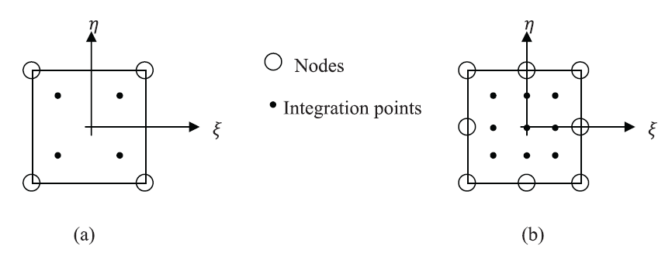
FEM implementation
Use FEM to solve:
  Forward problems
  Adjoint problems
  Hessian approximation
Values
  Potential u → FEM nodes
  Adjoint solution u*→ FEM nodes
  Cost function gradients (X,Y) → integration points

Slide 29
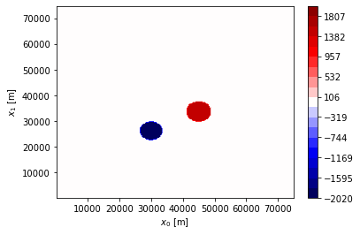
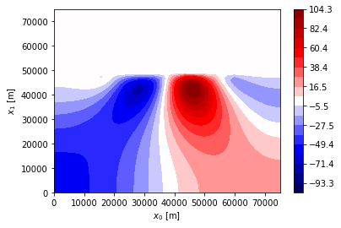
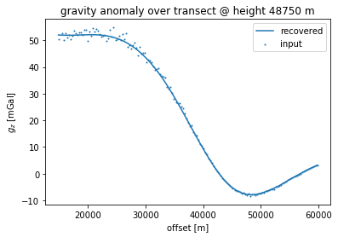
Gravity
True Density
Recovered

Slide 30
Inversion MT-TE
Conductivity model (needs to be non negative)
Electric field Ex solution of PDE
Predicted data

Slide 31
Gradient of MT Cost Function?

Slide 32
Adjoint Problem
Weak form of forward model:
Apply δ:
Adjoint problem: collect δu:

Slide 33
Gradient MT-TE Mode
Finally we have:
Put is all together:
Ready for the BFGS
Property function m is real

Slide 34
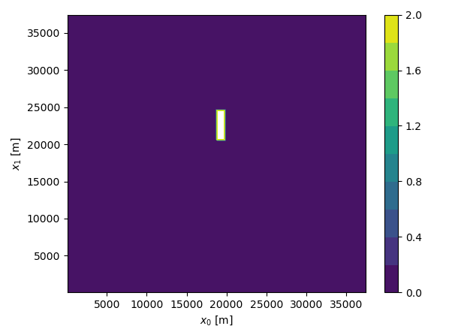
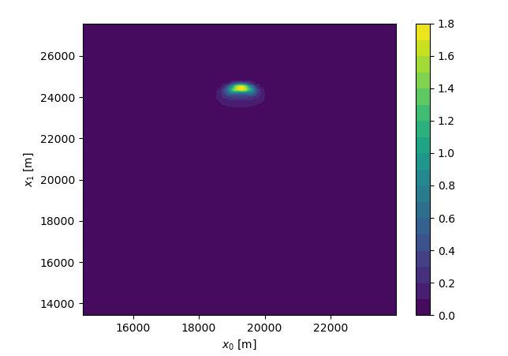
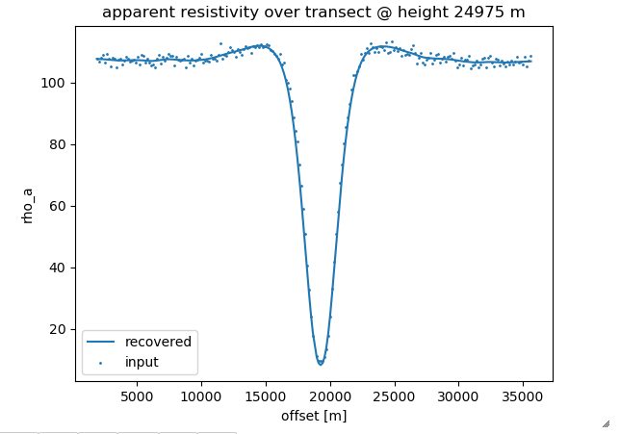
MT Example
f=5Hz, μ=10⁻²

Slide 35
Joint Inversion
Idea: invert for two or more physical properties simultaneously.
  Reduce the `degree of ill-posedness` - really???
  Create consistent distributions of physical properties.
How to connect two inversions?
  For instance Gravity and MT.

Slide 36
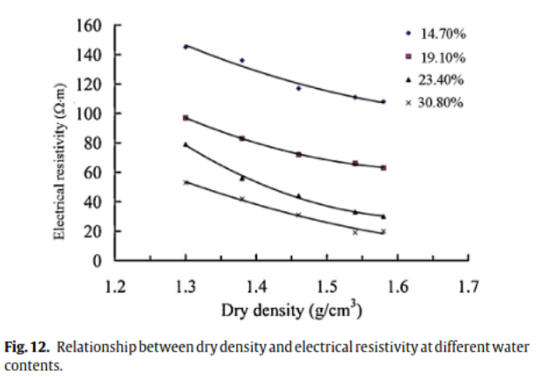
Constitutive Relationships
Explicit relationships are known
  typically empirical
  for instance: density as function of electric conductivity
Some lateritic soil
https://doi.org/10.1016/j.jrmge.2013.07.003

Slide 37
How to build the inversion?
Unknown: property function m
  Density and conductivity distribution are both parameterized with m:
Cost function to minimize:
  Tweak factors to adjust balance : α⁽¹⁾, α⁽²⁾
BFGS ready!

Slide 38
Without Constitutive Relationships?
Difficulties: It is an optimistic approach!
  Relationships are unknown
    Or can only obtained for shallow regions
  Relationships may be valid in certain regions but the extends of the regions are unknown
Assumption: There is a relationship between density and conductivity but the actual relationship is unknown.

Slide 39
Joint Inversion Set-up
Unknowns: m=(m₀, m₁)
If there is relationship between σ and ρ then also for the respective property functions m₀, m₁
Problem: Function G is not known!
Let’s assume it not depending on location x

Slide 40
Gradient Correlation
Apply spatial gradient:
This is a system of linear equations for (a₀,a₁):
  Two equations in 2D
  Three equations in 3D
Normal equation must have non-zero solution.

Slide 41
Gradient Correlation (cont.)
Multiply by ∇m₀ and by ∇m₁ :
For non-trival solution: determinant has to be zero:
    Notice: always C(m₀,m₁) ≥0
    Also known as Gram determinant
We want to minimize C(m₀,m₁) in the inversion

Slide 42
Cost Function
Cost function to minimize over m=(m₀, m₁):
https://doi.org/10.1093/gji/ggz134

Slide 43
Cross Gradient Form
Lagrange's identity:
Known as “cross-gradient” form
  Geometrical interpretation
  Target: make ∇m₀ and ∇m₁ parallel
conductivity
contour
normal
density contour
normal

Slide 44
Implementation
Solution by BFGS method
  Gradient:
https://doi.org/10.1093/gji/ggz134

Slide 45
Check Correlation
Measure of correlation:
  Good correlation: R²≈1
  Weak correlation: R²<<1
    Marks regions in which G is changing with x.
    Interpretation: interface of geological units

Slide 46
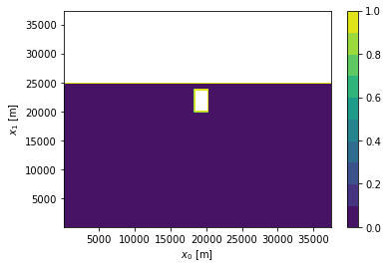
Test Case
f=5Hz, σ₁=2, ρ₁=1500
σ_{bg}=0.01, ρ’=500
α^{g}=1e-4, α^{mt}=0.0
μ^{g}, μ^{mt}=1e6
θ=1e8
62500 cells.

Slide 47
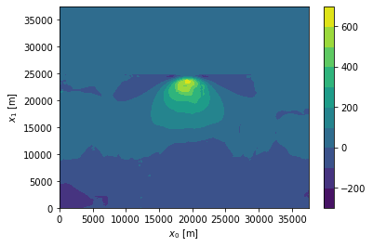
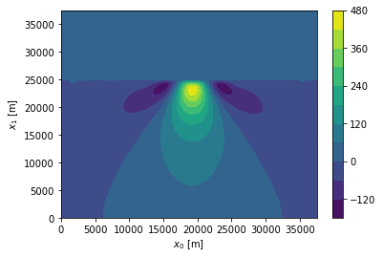
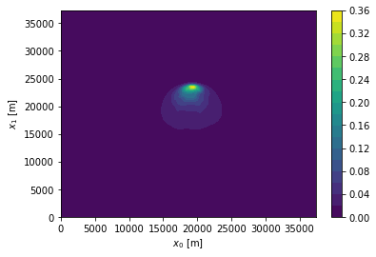
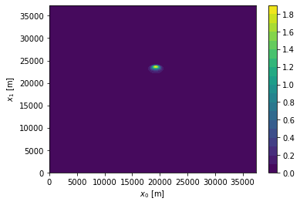
Properties
Joint inversion
Inversion θ=0
Density
Conductivity

Slide 48
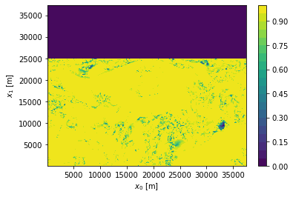
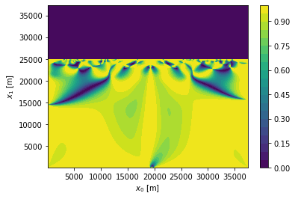
Correlation R²
Joint inversion
Inversion θ=0

Slide 49
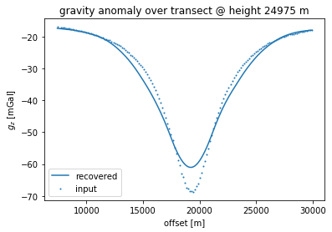
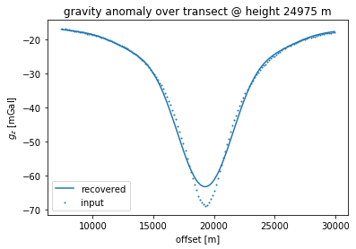
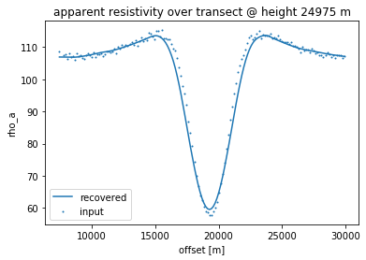

Data Recovery
Joint inversion
Inversion θ=0

Slide 50
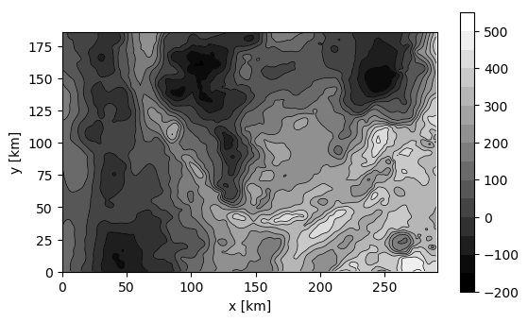
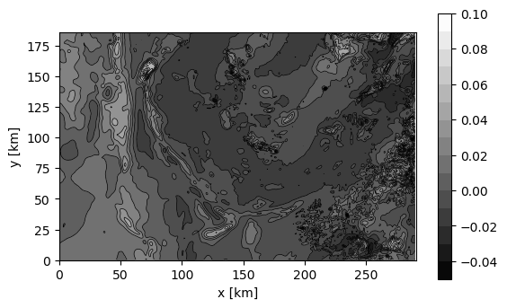
Field Data set from Central QLD
Gravity Anomalies QLD:
Magnetic field intensity QLD
Joint Inversion with 30 Million cells on ~200 cores
Implementation in python3 + esys-escript

Slide 51
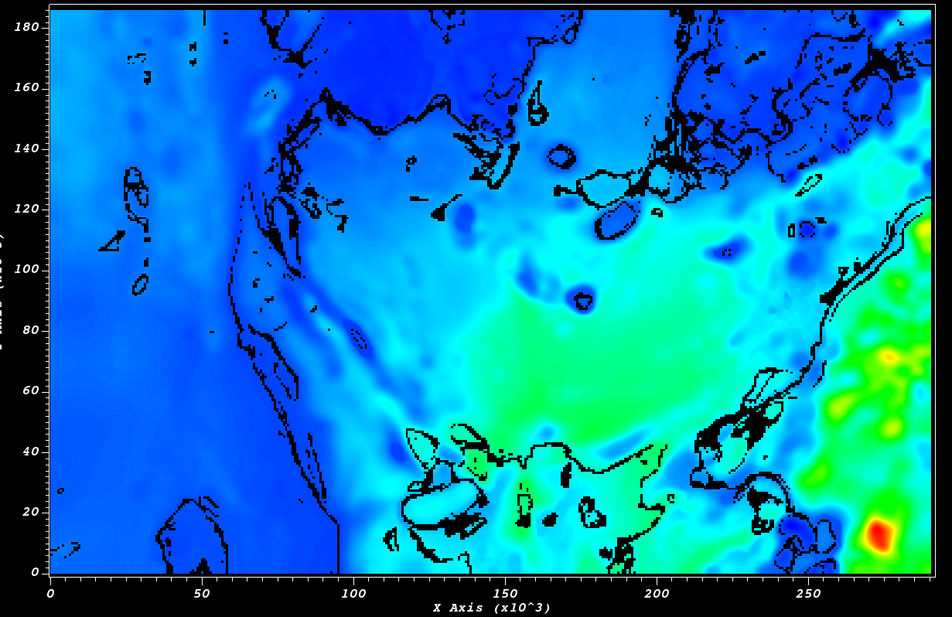
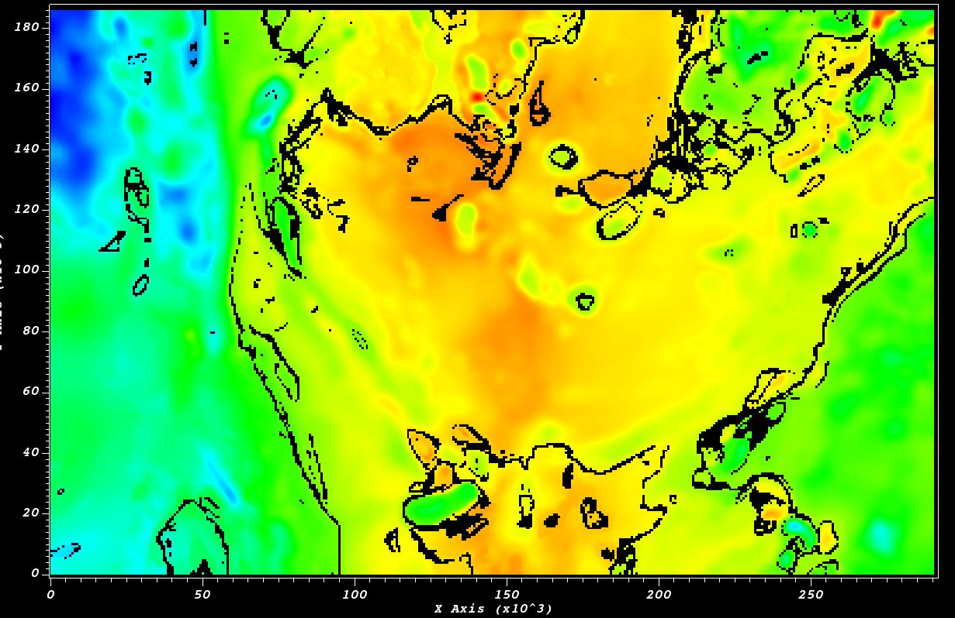
Some Results
Density at depth 500m
Log of susceptibility at depth 500m
Locations with R²<0.97
= boundary of geological units

Slide 52
Thanks!
Questions, Suggestions, Share programs:
Please get in contact on e-mail: l.gross@uq.edu.au
Or WeChat

